Slide 1

TITLE:AUTOMATED CANDIDATE RESUME SHORTLISTING SYSTEM
Student Name: Jahnavi Student ID: 2520030567)
Cluster: 1
Section: 4
Under the Guidance
of
Supervisor Name: Surekha Assistant Professor Department of CSE

Slide 2
The Creative Resume Shortlisting System is a smart application designed to help companies filter and rank candidates efficiently from a large number of resumes.When organizations receive many applications for a job role, manually reviewing each resume becomes time-consuming and inefficient.
This project uses Data Structures and Algorithms
(DSA) concepts such as arrays, linked lists, queues, hash maps, searching, and sorting algorithms to automate the shortlisting process.The system stores candidate information, analyzes their skills, compares them with required job skills, and ranks candidates based on a calculated match score.
By using these techniques, the system provides faster
resume processing, better candidate ranking, and efficient skill-based filtering, helping recruiters identify the most suitable candidates quickly.
ABSTRACT

Slide 3
EXISTING SYSTEM
. In the existing system, companies usually shortlist resumes manually.
Problems in the Existing System
Recruiters manually read hundreds or thousands of resumes.
The process is very time-consuming.
Human errors may occur while selecting candidates.
Difficult to quickly compare candidate skills with job requirements.
No automated ranking or filtering system.
Because of these issues, companies spend a lot of time and effort during recruitment.
y
3

Slide 4
SYSTEM | The proposed system is a Resume Shortlisting System that automatically processes resumes using DSA techniques. Features of Proposed System Companies can upload multiple resumes at once. Candidate skills are stored and organized using data structures.
The system compares candidate skills with job requirements. Each candidate receives a matching score.
PROPO | Candidates are sorted based on their score. Recruiters can easily see the top suitable candidates first. This system helps companies save time and improve recruitment efficiency. . 4
SED

Slide 5
 | Resume Upload ↓ Candidate Data Storage (Arrays / LinkedList / HashMap) ↓
Resume Processing (Queue + Skill Matching)
SYSTEM A | ↓ Candidate Ranking (Sorting Algorithm) ↓ Shortlisted Candidates Display 5
RCHITECTURE

Slide 6
 | Input Module This module collects candidate information such as name and skills.The recruiter enters multiple candidate details, which are used for the shortlisting process. Storage Module Candidate data is stored using arrays and linked lists. Arrays store candidate skills, while the linked list stores multiple candidate objects dynamically.
3. Processing Module Resumes are processed using a queue (FIFO).The system compares
PROJEC | candidate skills with the required job skills using a searching technique. Ranking Module Each candidate receives a match score based on the number of matching skills. Candidates are then sorted using a sorting algorithm so the best candidates appear first. Display Module The system displays the shortlisted candidates with their match scores, helping recruiters quickly identify the most suitable applicants. 6
T MODULES

Slide 7
Main Objectives
To automate the resume shortlisting process.
To reduce manual effort in recruitment.
To identify best candidates quickly based on skills.
Technical Objectives
Implement Data Structures in real-world applications.
Use arrays, linked lists, queues, and hash maps.
Apply searching and sorting algorithms.
Improve efficiency of candidate filtering.
OBJECTIVES
11-03-2026
173030211
Department of CSIT
7

Slide 8
NMENTS - A | CO | Topic Used | Where Used
 | CO1 | Linear Search | Skill matching
 | CO1 | Bubble Sort | Candidate ranking
AI DS | CO2 | Arrays | Storing skills
CO’S ATT | CO2 | Linked List | Storing candidate objects
 | CO3 | Queue | Resume processing
 | CO4 | HashMap | Skill based candidate lookup
8

Slide 9
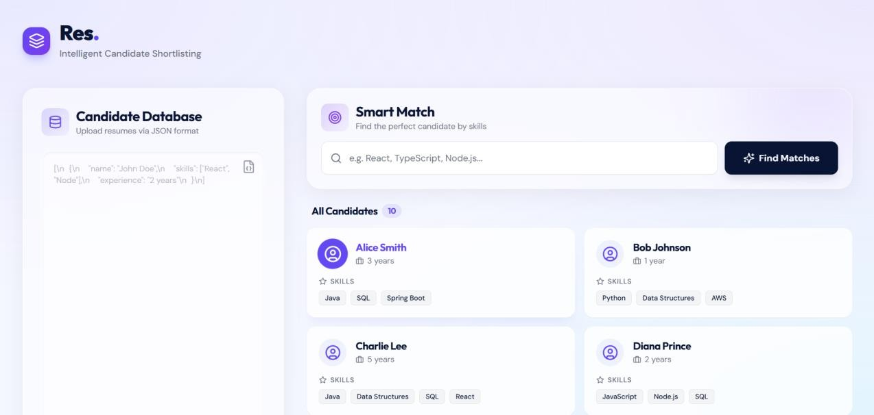
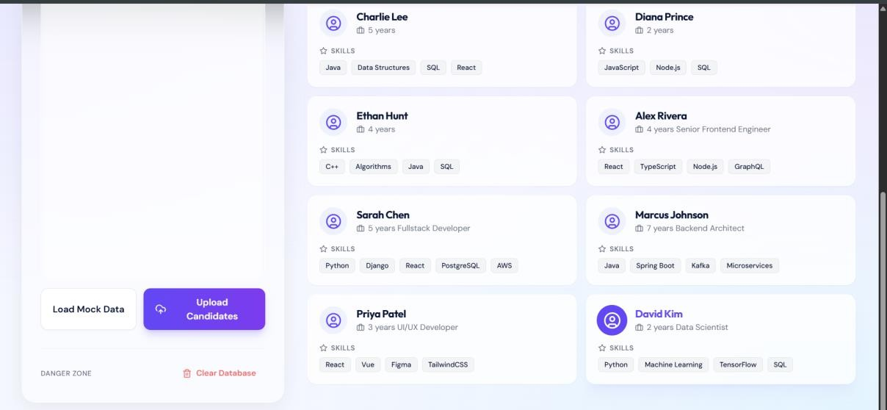
SCREENSHOTS FOR FWD & DSA
9

Slide 10
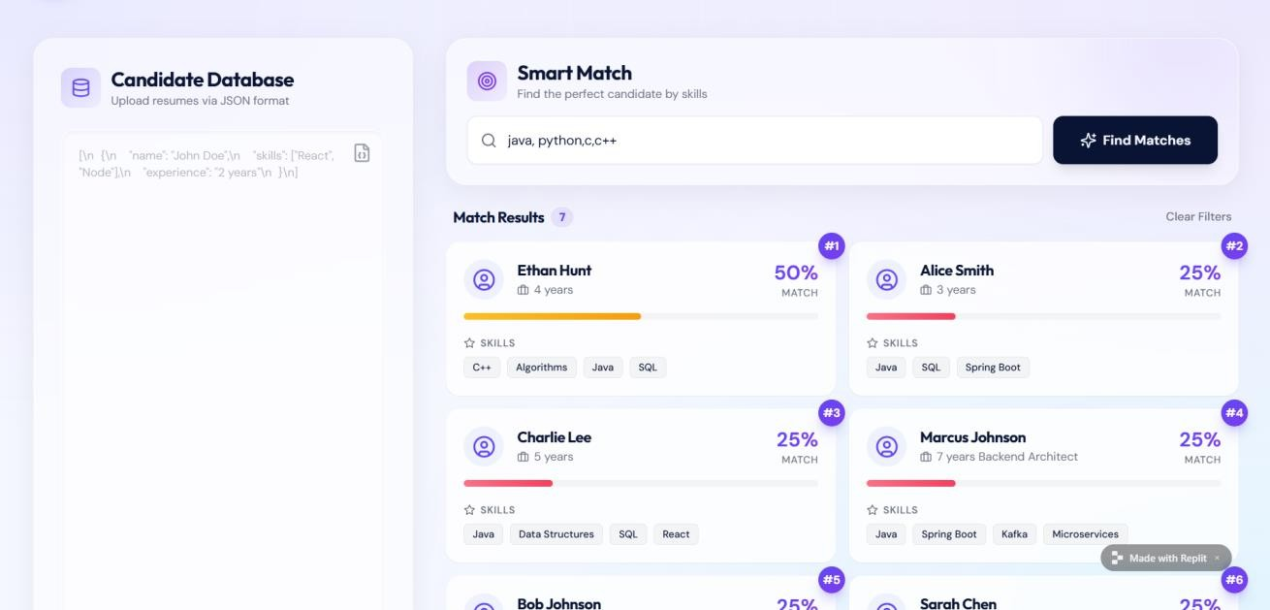
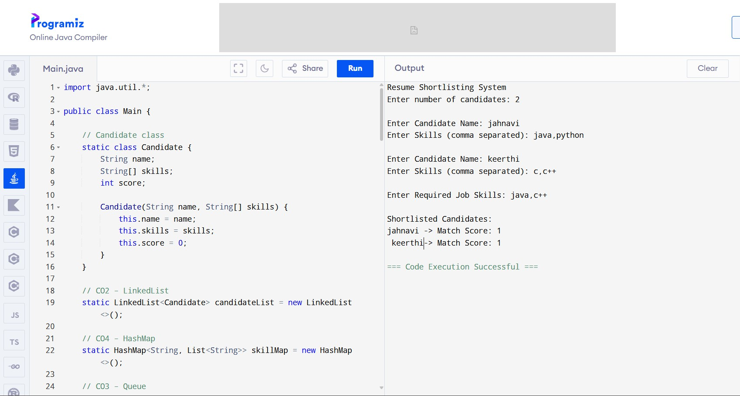
SCREENSHOTS FOR FWD & DSA

Slide 11
 | The Resume Shortlisting System helps companies simplify the recruitment process by automatically filtering and ranking candidates based on their skills. By using data structures such as arrays, linked lists, queues, and hash maps along with searching and
sorting algorithms, the system can efficiently process multiple resumes and identify the most suitable candidates. This project
CON | demonstrates how DSA concepts can be applied to solve real- world problems, making the recruitment process faster, more organized, and more effective.
CLUSION
11

Slide 12
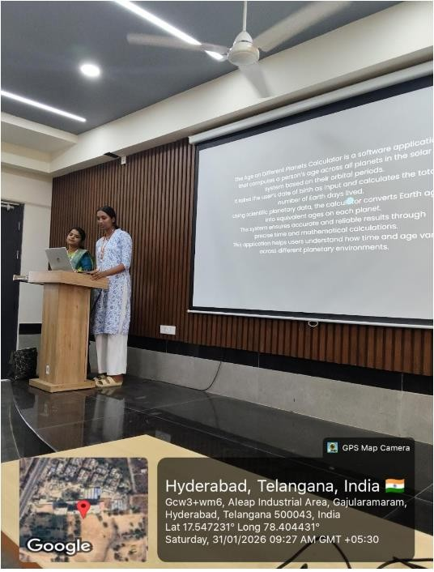

GEO- TAG PHOTOS

Slide 13
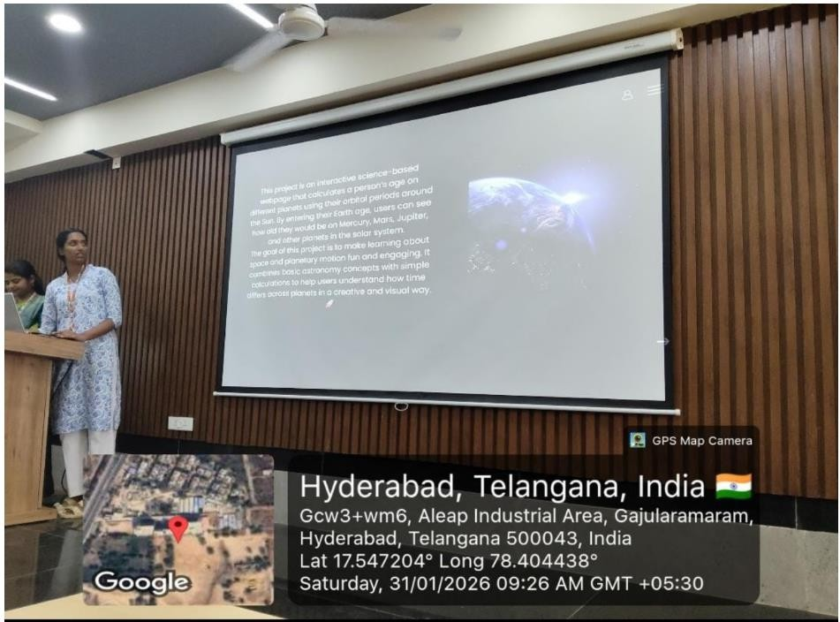

GEO- TAG PHOTOS

Slide 14
Thank You

